Slide 1

Customer Shopping Behavior Analysis
Exploring purchasing patterns from 3,900 orders to uncover actionable insights for strategic business planning and marketing optimization.

Slide 2
Dataset Overview
3,900
18
50
25
Total Orders
Data Features
Locations
Products
Comprehensive transactional data analyzed
Customer demographics and purchase details
Geographic distribution across regions
Diverse items across multiple categories
Key features include customer demographics, purchase details, shopping behavior metrics, and subscription status. Only 37 missing values found in Review Rating column.

Slide 3
Data Preparation Process
01
02
Data Loading & Exploration
Data Cleaning
Imported dataset using pandas and performed initial structure analysis with df.info() and summary statistics.
Handled missing values by imputing Review Rating with median ratings per product category.
03
04
Feature Engineering
Database Integration
Created age_group column and purchase_frequency_days from existing data for deeper analysis.
Connected to PostgreSQL and loaded cleaned data for structured SQL analysis.

Slide 4
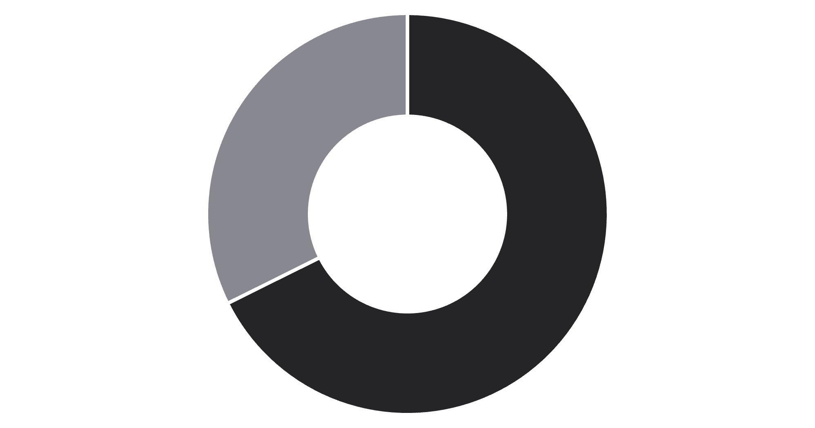
Revenue Insights by Gender
Male Customers Drive Revenue
Male customers generated $157,890 in total revenue, more than double the $75,191 from female customers.
This significant disparity suggests opportunities for targeted marketing to increase female customer engagement.
Male
Female

Slide 5
Top-Rated Products
77%
77%
76%
Gloves
Sandals
Boots
Highest average rating at 3.86 stars
Strong performance with 3.84 stars
Customer favorite at 3.82 stars
76%
76%
Hat
Skirt
Solid rating of 3.80 stars
Rounds out top 5 with 3.78 stars

Slide 6



Customer Segmentation Analysis
New
1
83 customers
Returning
2
701 customers
Loyal
3
3,116 customers
The customer base is dominated by loyal buyers (80%), indicating strong retention. However, the small new customer segment (2%) suggests a need for acquisition strategies.
Of repeat buyers with 5+ purchases, 958 are subscribers while 2,518 are not—revealing untapped subscription potential.

Slide 7
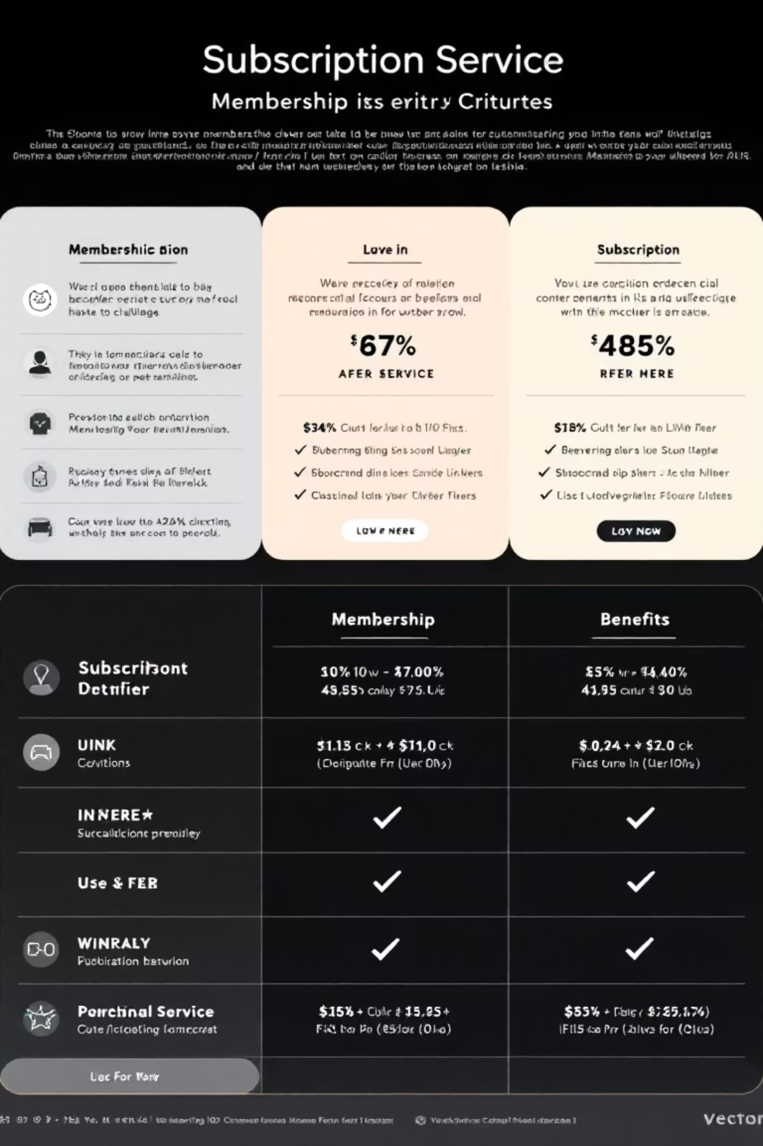
Subscription vs. Non-Subscription Performance
Subscribers
1,053 customers
Average spend: $59.49
Total revenue: $62,645
Non-Subscribers
2,847 customers
Average spend: $59.87
Total revenue: $170,436
Despite similar average spending, non-subscribers generate significantly more total revenue due to their larger population. Converting more customers to subscriptions could stabilize revenue streams.

Slide 8
Shipping & Discount Patterns
Shipping Type Impact
Smart Discount Users
Express shipping customers spend slightly more on average ($60.48) compared to Standard shipping users ($58.46).
839 customers used discounts but still spent above the average purchase amount.
This suggests premium shipping attracts higher-value customers.
Products like Hats (50% discount rate), Sneakers (49.66%), and Coats (49.07%) are most discount-dependent.

Slide 9
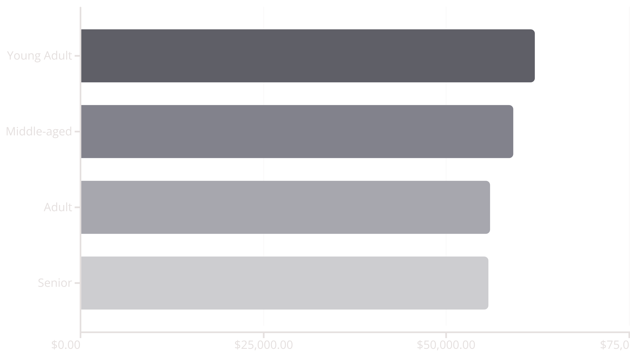
Revenue by Age Group
Young adults lead revenue generation at $62,143, followed closely by middle-aged customers. Revenue distribution is relatively balanced across age groups, indicating broad market appeal.

Slide 10

Strategic Recommendations
Boost Subscriptions
Enhance Loyalty
Optimize Discounts
Promote exclusive member benefits to convert repeat buyers into subscribers.
Implement rewards and incentives for repeat customers to strengthen retention.
Reassess discount structures to maintain profitability without sacrificing volume.
Feature Top Products
Targeted Marketing
Highlight top-rated items like Gloves and Sandals in marketing campaigns.
Focus efforts on high-revenue age groups and Express shipping users.

